Slide 1

Working Out God’s Inner Work
2:12 – 18
Week 36
9 November 2022

Slide 2

Philippians overview chapter two
In the second chapter, Paul continues the call for unity, provides reasons why we should desire unity, talks about the nature of our unity, and the attitudes necessary to maintain unity. Paul introduces the Philippians to a “Christlike descent into greatness” (1-4).
Stressing the need for selfless humility and sacrificial service towards others, Paul appeals to the example of Christ and expounds upon how far Christ was willing to go to save us (5-11).

Slide 3
Philippians Overview chapter two
Paul continues his exhortation to the Philippians to “shine as lights in the world” as they work out their own salvation with fear and trembling. Doing all things without complaining and arguing, while holding fast the word of life, they will prove themselves to be children of God in the midst of a crooked and perverse generation. Paul shares how the believer should be “working out God’s inner work” (12-16).
Which will prove to Paul that his labors has not been in vain, and shows that any persecution he endured was viewed as a sacrifice in the service of their faith and a cause for mutual rejoicing. (17-18).

Slide 4
Philippians overview chapter two
Paul then writes of his plans pertaining to Timothy and Epaphroditus. Paul reminds the Philippians of the relationship of these two men have with him: “a son and a brother.” He will send Timothy shortly, that he might learn of their condition (19-24).
But Epaphroditus is coming at once in order to set their hearts at ease about Epaphroditus’ brush with death due to his recent illness (25-30).

Slide 5


Slide 6

“Working Out God’s Inner Work”

Slide 7
Philippians 2:12 – 18
Examples are wonderful things. People who have gone before us and have lived admirable and exemplary lives are so valuable because they can show us how we ought to live. We can study the lives of great women and men throughout history who have lived inspirational and motivational lives and have set the stage for us to do the same.
While we have many examples of good and godly people to imitate, ultimately, we look to the radical obedience exemplified in Christ’s selfless humility, as described in Philippians 2:6-11. He left the glories of heaven to take on inglorious humanity and live amid suffering, sin, and death. He veiled the brilliance of His divine attributes and willingly accepted the limitations of human life.

Slide 8
Philippians 2:12 – 18
He relinquished angelic adoration and praise to become a victim of torture, and ultimately, of an excruciating death on a cross. And He carried out all of this in perfect obedience. Not one flaw. Not one inconsistency. Not one impatient word. Not one misstep or stray thought contrary to the Father’s will.
Mark Twain once wrote, “Few things are harder to put up with than the annoyance of a good example.” What about an impossible example” I’m not a God-man. Neither are you. Only Jesus, the incarnate Son of God, could embody this kind of supernatural humility and miraculous obedience. How in the world are we expected to follow Paul’s exhortation: “Have this attitude in yourselves which was also in Christ Jesus” (2:5)?

Slide 9
Philippians 2:12 – 18
We can barely follow the good examples of fallen sinners like us! Some folks halfheartedly try to follow Christ’s example by faking it in an effort to please others or earn recognition. Like a pop star lip-syncing lyrics on stage while adoring fans look on in ecstasy, some Christ followers put on an outward show when everybody’s watching. Then they wipe off the made-up virtues back in their dressing rooms where nobody can see. They focus on image rather than substance, doing rather than being.
Some attempt to live obediently because they think God is some kind of cosmic vending machine that you can pay with good deeds and receive what you want in return. They follow Christ, fully expecting to experience blessing here and now . . .

Slide 10
Philippians 2:12 – 18
. . . usually material riches, physical healing, power, or fame. They want the ecstasy without the agony. They want the glory without the suffering. Perhaps they even want mature obedience, but without the long, buffeting work of patient endurance.
Neither of these attempts at following Christ’s example in Philippians 2:6-11 were what Paul had in mind when he exhorted his audience to conform to the perfect example of Christ. Rather, he wanted them to have a radical new attitude and trajectory. This new trajectory would not lead to earthly perfection, but toward eternal perfection, in a long process of sanctification.

Slide 11
Philippians 2:12 – 18
It’s a life headed in the direction of the perfect obedience of Christ but fully dependent on the inner work of the Holy Spirit to progressively lead in that journey.
In Philippians 2:12-18, this passage shows us what it looks like to work out that inner working of the Spirit. This passage strikes a perfect balance between our natural condition in which Christlike obedience is impossible and the supernatural inner work of God, which enables us to strive for Christlikeness.

Slide 12
Philippians 2:12 – 13
¹²Therefore my beloved, as you have always obeyed, not as in my presence only, but now much more in my absence, work out your own salvation with fear and trembling; ¹³for it is God who works in you both to will and to do for His good pleasure.

Slide 13
Philippians 2:12 – 13
With a conjunction meaning “therefore” or “for this reason,” Paul links 2:12 logically with his previous description of Christ’s preeminent example of selfless humility. In light of Christ’s example of profound obedience, the Philippians are to build on their own non-hypocritical obedience. At this point, Paul gives them a strange command: “Work out your salvation with fear and trembling” (2:12).
With just a cursory reading of 2:12, we might conclude that Paul is suggesting we need to work hard to earn our salvation! And to make matters worse, we should be shaking in our boots for fear that we might not do enough! If Paul had skipped straight to 2:14, we might be under the impression that Christlikeness is entirely up to us . . .

Slide 14
Philippians 2:12 – 13
. . . that God did His part by giving us the example of Christ, and now we’re to do the hard work of imitation. But this would be a hasty and false conclusion. Remember that Paul’s readers are authentic, born-again believers in Christ. God had already begun a good work in them and would complete it (1:6). So this notion of working out their salvation is not meant to suggest that they are to work for their salvation.
We can better understand what Paul means by reminding ourselves of the broader context. What is Paul urging in Philippians 2? He begins by exhorting his readers to like-minded unity, love, and purposefulness, along with the avoidance of selfishness and conceit (2:2-4) as Christ demonstrated (2:5-11).

Slide 15
Philippians 2:12 – 13
In 2:14-15 he again emphasizes how they are to treat each other in the fellowship of the saints. He urges them to avoid grumbling and disputing, encouraging them to be “blameless and innocent” in the midst of a dark and twisted world.
So, we can understand the imperative of 2:12 in this context. The Philippians are to work out their salvation not in the sense of earning it, but expressing the reality of their salvation through their practical obedience and selfless humility.
The emphasis is on sanctification (learning to live more righteously), not on justification (being declared righteous).

Slide 16
Philippians 2:12 – 13
But recognizing our inability to practice this kind of Christlike obedience on our own, Paul explains how Christian obedience actually works. It’s like Paul removes the access panel from the Christian life and we catch a brief glimpse of the inner working that would otherwise remain unseen.
We’re able to work out this salvation in real obedience because God Himself—through His indwelling Spirit—is at work in us “both to will and to work for His good pleasure” (2:13). As we submit ourselves to the working of His Spirit, He gives us both the desire and the power to accomplish His will. He does His invisible work in us by grace; we simply do what He has commanded.

Slide 17
Philippians 2:12 – 13
If we could see the invisible inner working of God with our eyes, it would take our breath away. He’s the One who is striving! He’s the One at work! He’s the One empowering us to do the impossible.
It’s not our spirit that somehow self-motivates us and perpetuates obedience. The Spirit of Christ works within us to make us into the people he wants us to be.

Slide 18
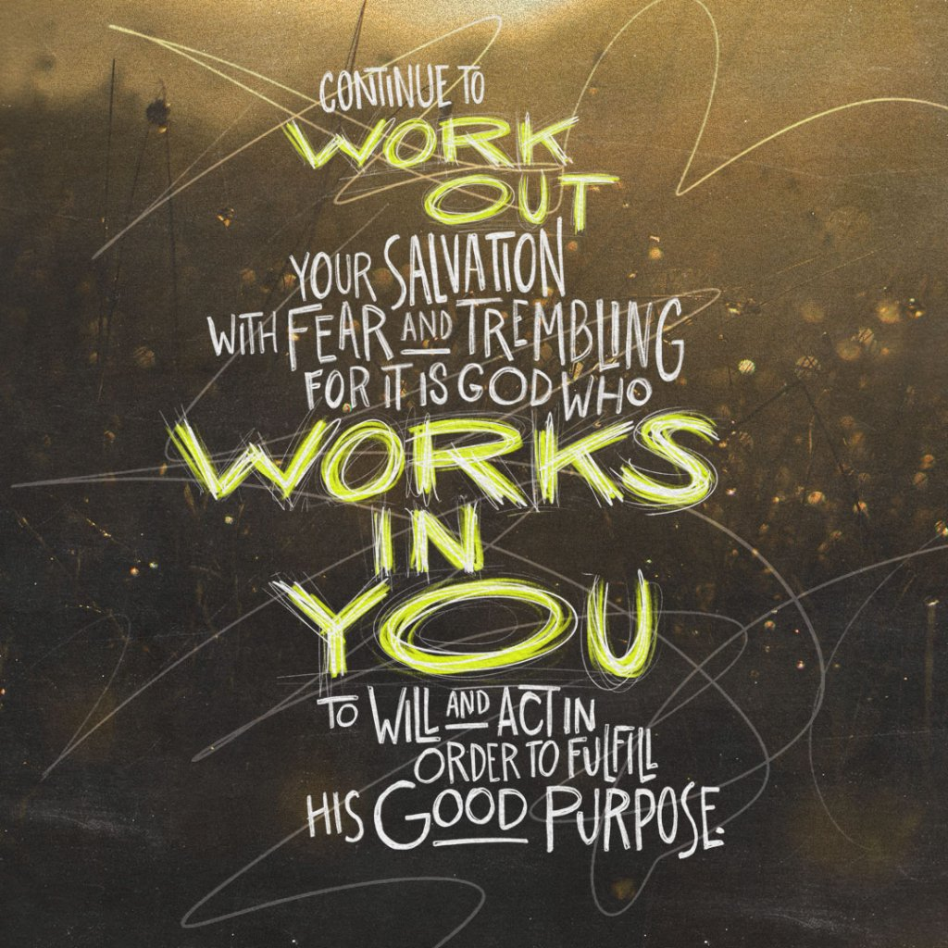

Slide 19
Philippians 2:14 – 16a
¹⁴Do all things without complaining and disputing, ¹⁵that you may become blameless and harmless, children of God without fault in the midst of a crooked and perverse generation, among whom you shine as lights in the world, ¹⁶holding fast the word of life . . .

Slide 20
Philippians 2:14 – 16a
Next Paul provides a more detailed picture of what working out God’s inner work looks like. It affects our attitude (2:14) and actions (2:15). We’re to do everything “without grumbling or disputing” (2:14). In Greek, the word for “grumbling” sounds like a person mumbling complaints under their breath.
This is coupled with “disputing,” which refers to complaining and arguing with others, stirring up dissension and causing strife. These reflect bad attitudes of discontent and discord—the antitheses of joy.
By checking these joyless attitudes, we demonstrate ourselves to be “blameless and innocent” and “above reproach,” as Christ was (2:15; cf. 2:5).

Slide 21


Slide 22
Philippians 2:14 – 16a
Our actions will cause us to shine like brilliant lights in a dark world, or like unending pillars in a crooked culture. God’s goal for His children is not that we retreat from this world into secluded communities. Nor is it His desire that we blend into the world so much that our witness wanes. We are to “[hold] fast the word of life” (2:16), letting nothing slip our grasp as we seek to illumine Christ to all those we encounter.
Jesus said, “You are the light of the world. A city set on a hill cannot be hidden; nor does anyone light a lamp and put it under a basket, but on the lampstand, and it gives light to all who are in the house. Let your light shine before men in such a way that they may see your good works, and glorify your Father who is in heaven” (Matthew 4:14-16).

Slide 23
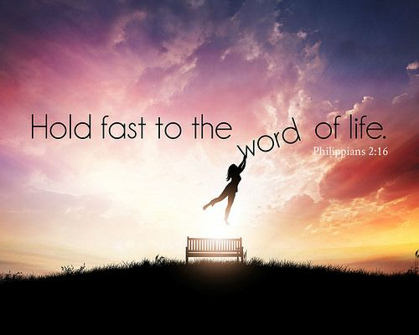

Slide 24
Philippians 2:14 – 16a
Not only did Jesus say it, but He lived it. And He wants to continue to shine forth through us.
Christians who live with an attitude of joy rather than grumbling and whose pure lives shine like lights in the world will be the talk of the town. They will transform the morale at the office. They will become agents of change at school. And if the church as a whole is focused on fueling the lights of joyful Christlikeness rather than feeding the fires of mean-spirited conflict, imagine what that could do for our nation or even the world!

Slide 25
Philippians 2:16b – 18
¹⁶ . . . so that I may rejoice in the day of Christ that I have not run in vain or labored in vain. ¹⁷Yes, and if I am being poured out as a drink offering on the sacrifice and service of your faith, I am glad and rejoice with you all. ¹⁸For the same reason you also be glad and rejoice with me.

Slide 26
Philippians 2:16b – 18
When the Philippians truly lived out the reality of the inner work of the Spirit in both joyful attitudes and faithful action (2:14-16b), Paul would be able to see a positive return on his investment of blood, sweat, and tears on their behalf (cf. 1Cor. 9:24-27). Paul’s lingering concern for all the churches he had planted is that he not be like the runner whose endless hours of training achieved nothing, or like the laborer whose exhausting work produced no results (2:16b).
Instead, Paul prays that his labor will positively impact the Philippians’ ongoing, Christlike, sacrificial service to God. In 2:17, Paul’s tone switches momentarily as he focuses on the grim reality that he could conceivably pour out his very life as a sacrifice for the faith of the Philippians.

Slide 27
Philippians 2:16b – 18
As to the sacrificial imagery Paul uses in this verse, one commentary notes, “In the ancient world, sacrifices, both pagan and Jewish, were usually accompanied and completed by a libation of wine poured out either on top of the sacrifice or at the foot of the altar to honor the deity.”
This “being poured out,” indicates that Paul felt his life draining away during his long wait for trial, and his life being prepared as a “drink offering” for the Lord on behalf of the churches he served.
Paul had come face-to-face with all sorts of mortal dangers throughout his apostolic ministry. His imminent trial before Caesar’s court was just the latest looming threat that could result in execution. But in classic Pauline style, he balance his somberness with joy.

Slide 28
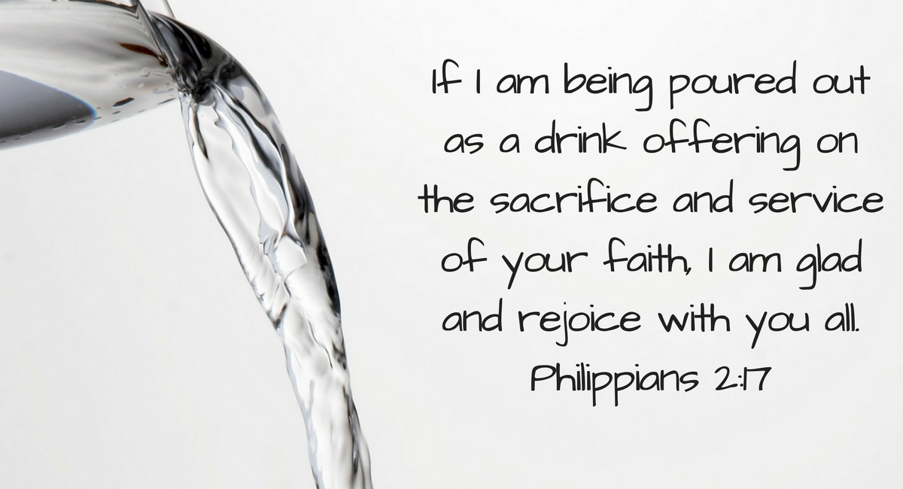

Slide 29
Philippians 2:16b – 18
Even if his life were “poured out as a drink offering,” he would rejoice, viewing this as a “service” toward the Philippians (2:17). Paul also invited the Philippians to “rejoice in the same way” and share their joy with him (2:18).
Swindoll quoting William Barclay, adds some perspective to this mutual joy: “Paul was perfectly willing to make his life a sacrifice to God; and, if that happened, to him it would be all joy, and he calls on the Philippians not to mourn at the prospect but rather to rejoice. To him, every call to sacrifice and to toil was a call to his love for Christ, and therefore he met it not with regret and complaint but with joy.”

Slide 30


Slide 31
Philippians 2:12 – 18
APPLICATION: From Paul’s perspective on working out God’s inner work in the Christlike life, we recognize that we have one primary enemy who will keep us from walking in step with the Spirit’s work: SELF—that is, the sinful self-centeredness inherent in our fallen nature.
As soon as we begin to make a little headway, SELF is there to tell us we’re pretty special and deserving of praise. That’s when true selfless humility flies away and Spirit-empowered obedience comes crashing down.
Even with Christ’s example and the Spirit’s power, living out our new inner life won’t be easy because of SELF. Inside each of us is a rebellious nature that will do everything it can to upset our Christlikeness.

Slide 32
Philippians 2:12 – 18
APPLICATION: SELF will dispute, pout, shout, and pull all sorts of shenanigans to convince us to leave God out of our lives and just trust in SELF. Don’t let it! Remember Proverbs 16:18: “Pride goes before destruction, and a haughty spirit before stumbling.” Consider the following two inner workings by the power of the Holy Spirit . . .
Control SELF’s urges to take the credit. Like Paul, make it your goal to exalt Christ, not SELF, in everything. Granted, that won’t be easy, but through God’s power our hearts and minds can learn to live for Him more than for ourselves. It won’t happen overnight. It will require God mercifully and repeatedly picking you up after stumbling. But eventually, with God’s enabling grace, SELF can be weakened and begin to lose more battles than it use to win.

Slide 33
Philippians 2:12 – 18
APPLICATION: Conquer SELF’s tendency to take charge. SELF doesn’t like to sit in the backseat or take the passenger side. SELF wants complete control. Don’t give in. It is a winnable conflict. But expect a life-long battle, because SELF will never surrender, never negotiate, and never give in until we die or Christ returns and transforms our sinful SELF into conformity with His glory
If we depend on our own fallen nature, we’ll never work out God’s inner work in our lives. Rather, we must lean on Christ to work in us by the power of the Spirit. If we do, He’ll help us maintain a Christlike walk, not in constant panic, but with inexplicable joy.

Slide 34



Slide 35
NEXT CLASS – 16 November 2022
Book of Philippians
Before next class, read the below verses in the NKJV and in one other versions of the Bible, i.e., NIV, NRSV, KJV, CEV, etc …
Chapter 2:19 – 30
“A Son and A Brother”

